Slide 1
GENERAL SITUATION IN SHIPPING
PARTNER.SHIP.REDEFINED.
PDB-01-000

Slide 2
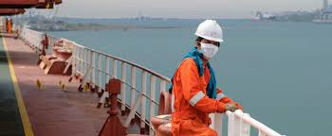
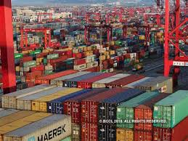
GENERAL SITUATION IN SHIPPING 2020 -2021
2020 – Year of the global COVID 19 Pandemic and possibly as the year the container market finally turned the corner.
After the industry had seemingly digested the implementation of the IMO 2020 Sulphur cap without any notable hiccups and while preparing for a seemingly quiet and uneventful year, February 2020 saw the COVID 19 virus become a worldwide pandemic causing unprecedented restrictions on travel and trade.
The restrictions on crew changes was one of the dominating subjects of 2020, despite efforts by all industry stakeholders to resolve this humanitarian crisis. Not only that it was more difficult to plan and realize timely crew changes caused by Covid-19 restrictions and its requirements, but also analysis showed that crew changes have become substantially more expensive. Mandatory quarantine, PCR testing, extended overlaps and a limited availability of flights etc. required ship operators to set aside additional funds for their upcoming budgets.
The second half of 2020, especially the last quarter saw an unexpected rise in container shipping. The fact that many container lines were trying to secure long term employment has led to tramp owners quietly hoping that this upturn could be the beginning of a longer sunny spell for the container market. Bulk and Multipurpose / Heavy lift vessels were not directly affected by this upswing with the bulker market remaining volatile and the MPP / Heavy lift ships showing a stable performance however still heavily impacted by the Corona downturn.
The overall goal to reduce emissions remains and rates very high in the maritime industry. Green shipping can be achieved not only by broadening the network of shore power supply, new means of propulsion and usage of alternative fuels. The pandemic as well as high costs associated with green shipping still hamper the wide scale implementation of environmental friendly measures.

Slide 3
THANK YOU!

